Slide 1
Prevention of mother to child transmission and early infant diagnosis in Malawi: Accomplishments of a mature Option B+ program in a resource-limited setting
Kim E,¹ Payne D, ¹ Cuervo-Rojas J,² Eliya M,³ Kalua T,³ Jahn A,³ Nzima M,⁴ Auld A,¹ West C,¹ Wadonda-Kabondo N,¹ Jonnalagadda S⁵ for the MPHIA Study Team
¹ Centers for Disease Control and Prevention, Lilongwe, Malawi
² ICAP for Columbia University, New York, USA
³ Ministry of Health, Lilongwe, Malawi
⁴ UNAIDS, Lilongwe, Malawi
⁵ Centers for Disease Control and Prevention, Atlanta, USA
July 2018
International AIDS Conference
Center for Global Health
Division of Global HIV and Tuberculosis

Slide 2
PMTCT in Malawi
In 2011, Malawi was the first country to launch “Option B+” for prevention of mother to child transmission of HIV (PMTCT)
Routine program data have indicated successful scale-up
Quarterly program data show >90% of HIV-positive pregnant women on ART¹
Some questions remain about PMTCT coverage, retention, and early infant diagnosis (EID) testing
¹ Ministry of Health, Malawi. Integrated HIV Program Report, 2017.

Slide 3
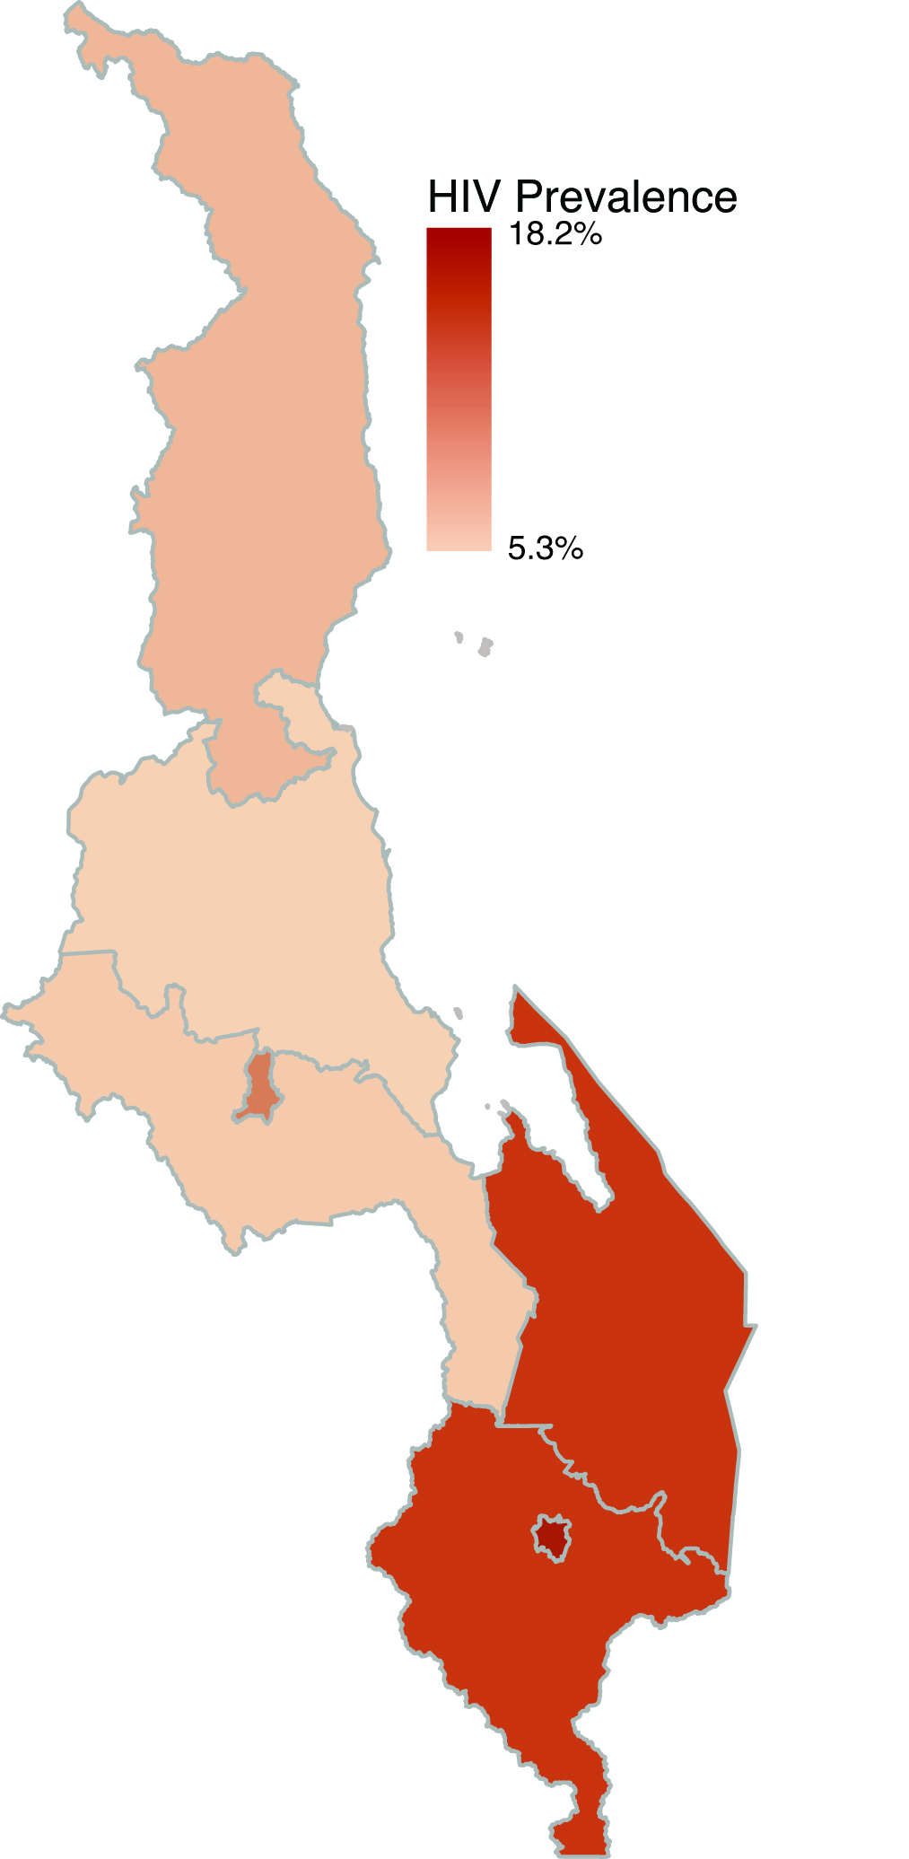
Malawi Population-based HIV Impact Assessment (MPHIA 2015-2016)
Two-stage cluster design
Stage 1: 500 enumeration areas across 7 zones
Stage 2: 14,268 households
Eligible women were consented and interviewed about most recent pregnancy in last 3 years and PMTCT/EID cascade
National adult HIV prevalence: 10.0%¹
HIV prevalence among women aged 15-49: 12.1%
HIV Prevalence
¹ Ministry of Health, Malawi. Malawi Population-based HIV Impact Assessment (MPHIA) 2015-2016: First Report, 2017.

Slide 4
PMTCT Analysis, MPHIA 2015-2016
Analysis objectives:
To measure PMTCT/EID cascade
To assess factors associated with gaps in the PMTCT/EID cascade
Analysis limited to women aged 15-49 years reporting a live birth in the 3 years before the survey (N=3,598)
Survey data weighted for design and non-response
Jackknife replication method to estimate variance
Attend ANC
HIV status ascertained
Mother on ART
Infant on prophylaxis
EID testing

Slide 5
Characteristics of women aged 15-49 years by self-reported HIV status at last pregnancy,* MPHIA 2015-2016
 | HIV - (N=3,209) |  | HIV + (N=302)
 | % | 95% CI | % | 95% CI
Age 15-19 20-29 30-39 40-49 | 12.5 57.0 25.3 5.2 | 11.3-13.9 55.5-58.5 24.0-26.6 4.4-6.1 | 2.7 40.5 47.6 9.2 | 1.2-6.0 34.6-46.7 41.3-54.0 5.9-14.1
Residence Urban Rural | 15.3 84.7 | 13.0-17.9 82.1-87.0 | 22.7 77.3 | 18.1-28.1 72.1-81.9
Education No education or primary Secondary or higher | 79.1 20.9 | 77.2-80.8 19.2-22.8 | 79.7 20.3 | 73.9-84.4 15.6-26.1
Parity 1 2-3 4+ | 28.5 39.4 32.2 | 26.8-30.3 37.5-41.3 30.5-33.9 | 8.5 38.4 53.0 | 5.6-12.8 32.8-44.4 46.6-59.3
Was most recent pregnancy planned Yes No | 47.8 52.2 | 45.9-49.7 50.3-54.1 | 39.5 60.5 | 33.0-46.5 53.5-67.0
* Among women who reported a birth in the last 3 years before the survey.

Slide 6
Characteristics of women aged 15-49 years by self-reported HIV status at last pregnancy,* MPHIA 2015-2016
 | HIV - (N=3,209) |  | HIV + (N=302)
 | % | 95% CI | % | 95% CI
Age 15-19 20-29 30-39 40-49 | 12.5 57.0 25.3 5.2 | 11.3-13.9 55.5-58.5 24.0-26.6 4.4-6.1 | 2.7 40.5 47.6 9.2 | 1.2-6.0 34.6-46.7 41.3-54.0 5.9-14.1
Residence Urban Rural | 15.3 84.7 | 13.0-17.9 82.1-87.0 | 22.7 77.3 | 18.1-28.1 72.1-81.9
Education No education or primary Secondary or higher | 79.1 20.9 | 77.2-80.8 19.2-22.8 | 79.7 20.3 | 73.9-84.4 15.6-26.1
Parity 1 2-3 4+ | 28.5 39.4 32.2 | 26.8-30.3 37.5-41.3 30.5-33.9 | 8.5 38.4 53.0 | 5.6-12.8 32.8-44.4 46.6-59.3
Was most recent pregnancy planned Yes No | 47.8 52.2 | 45.9-49.7 50.3-54.1 | 39.5 60.5 | 33.0-46.5 53.5-67.0
* Among women who reported a birth in the last 3 years before the survey.

Slide 7
Characteristics of women aged 15-49 years by self-reported HIV status at last pregnancy,* MPHIA 2015-2016
 | HIV - (N=3,209) |  | HIV + (N=302)
 | % | 95% CI | % | 95% CI
Age 15-19 20-29 30-39 40-49 | 12.5 57.0 25.3 5.2 | 11.3-13.9 55.5-58.5 24.0-26.6 4.4-6.1 | 2.7 40.5 47.6 9.2 | 1.2-6.0 34.6-46.7 41.3-54.0 5.9-14.1
Residence Urban Rural | 15.3 84.7 | 13.0-17.9 82.1-87.0 | 22.7 77.3 | 18.1-28.1 72.1-81.9
Education No education or primary Secondary or higher | 79.1 20.9 | 77.2-80.8 19.2-22.8 | 79.7 20.3 | 73.9-84.4 15.6-26.1
Parity 1 2-3 4+ | 28.5 39.4 32.2 | 26.8-30.3 37.5-41.3 30.5-33.9 | 8.5 38.4 53.0 | 5.6-12.8 32.8-44.4 46.6-59.3
Was most recent pregnancy planned Yes No | 47.8 52.2 | 45.9-49.7 50.3-54.1 | 39.5 60.5 | 33.0-46.5 53.5-67.0
* Among women who reported a birth in the last 3 years before the survey.

Slide 8
Characteristics of women aged 15-49 years by self-reported HIV status at last pregnancy,* MPHIA 2015-2016
 | HIV - (N=3,209) |  | HIV + (N=302)
 | % | 95% CI | % | 95% CI
Age 15-19 20-29 30-39 40-49 | 12.5 57.0 25.3 5.2 | 11.3-13.9 55.5-58.5 24.0-26.6 4.4-6.1 | 2.7 40.5 47.6 9.2 | 1.2-6.0 34.6-46.7 41.3-54.0 5.9-14.1
Residence Urban Rural | 15.3 84.7 | 13.0-17.9 82.1-87.0 | 22.7 77.3 | 18.1-28.1 72.1-81.9
Education No education or primary Secondary or higher | 79.1 20.9 | 77.2-80.8 19.2-22.8 | 79.7 20.3 | 73.9-84.4 15.6-26.1
Parity 1 2-3 4+ | 28.5 39.4 32.2 | 26.8-30.3 37.5-41.3 30.5-33.9 | 8.5 38.4 53.0 | 5.6-12.8 32.8-44.4 46.6-59.3
Was most recent pregnancy planned Yes No | 47.8 52.2 | 45.9-49.7 50.3-54.1 | 39.5 60.5 | 33.0-46.5 53.5-67.0
* Among women who reported a birth in the last 3 years before the survey.

Slide 9
PMTCT/EID Cascade, MPHIA 2015-2016
Overall, 79.7.0% (95% CI: 74.1 – 85.2) of women self-reporting HIV-positive status reported that their child had an EID test
Of those reporting EID testing, 3.9% (95% CI: 1.4-6.4) reported a HIV-positive result

Slide 10
EID uptake associated with higher maternal education level

Slide 11
EID uptake associated with maternal disclosure of HIV status to family

Slide 12
EID uptake associated with infant uptake of co-trimoxazole prophylaxis

Slide 13
Factors associated with EID within 2 months of birth, MPHIA 2015-2016
 | Crude OR (95% CI) | aOR* (95% CI)
Education Secondary or higher Primary or less | 2.9 (1.5 – 5.6) Ref. | 2.7 (1.3-5.5) Ref.
Family disclosure Yes No | 2.3 (1.3 – 4.2) Ref. | 2.3 (1.3-4.2) Ref.
Infant on prophylaxis Yes No | 5.9 (2.8 – 12.2) Ref. | 6.0 (2.8-12.8) Ref.
*Adjusted for urban/rural residence and age

Slide 14
Discussion
ANC attendance, awareness of HIV status, and uptake of PMTCT were high
EID testing within two months of birth, as recommended in the Malawi National Guidelines, was the largest gap in the PMTCT/EID cascade
Family disclosure, maternal education, and infant prophylaxis were significantly associated with timely EID testing

Slide 15
Limitations
Temporality of EID testing and family disclosure cannot be established in this cross-sectional survey
Possible social desirability bias in self-reported HIV status, ARV use during pregnancy, and EID testing

Slide 16
Conclusions
MPHIA 2015-2016 data demonstrate the success of Malawi’s Option B+ program
EID coverage may be improved through enhanced counseling on disclosure and increased infant prophylaxis uptake
While findings confirm good PMTCT performance, identifying remaining gaps and areas for intervention are key to achieving EMTCT in Malawi

Slide 17
Acknowledgements
MPHIA study participants
MPHIA field teams
Malawi Ministry of Health
CDC Atlanta and CDC Malawi
ICAP at Columbia University, NY and ICAP Malawi
Malawi Centre for Social Research
Malawi National Statistical Office
Johns Hopkins Project – College of Medicine
WESTAT
This project is supported by the U.S. President’s Emergency Plan for AIDS Relief (PEPFAR) through CDC under the terms of cooperative agreement #U2GGH001226. The results and findings in this report do not necessarily reflect the views of the funding agencies.

